Slide 1

Using AI to accurately process paper forms
Team Members:
Jeff Shamley
Alex Fearday
Valencia Vaughn
Josh Westerlund

Slide 2

The Pain

Slide 3
The Value Proposition
Dentist Offices are slow to change and still use paper forms
Requires front office staff to input data manually in FUSE
Time-consuming and error-prone
Offices scan in insurance cards and enter the data manually
Redundant and error-prone

Slide 4

What If…
Let the offices use whatever forms they want, have them scan all the forms and insurance cards, and let AI take care of the rest.

Slide 5
Technology
Dynamsoft Scanner – Already used in FUSE to scan documents
Azure AI
Insurance Card Model already exists
Document Model requires training on new patient forms
All data from scanned documents comes back in JSON key value pairs
Create middleware to process JSON and send data to the corresponding endpoints in FUSE

Slide 6
Demo

Slide 7
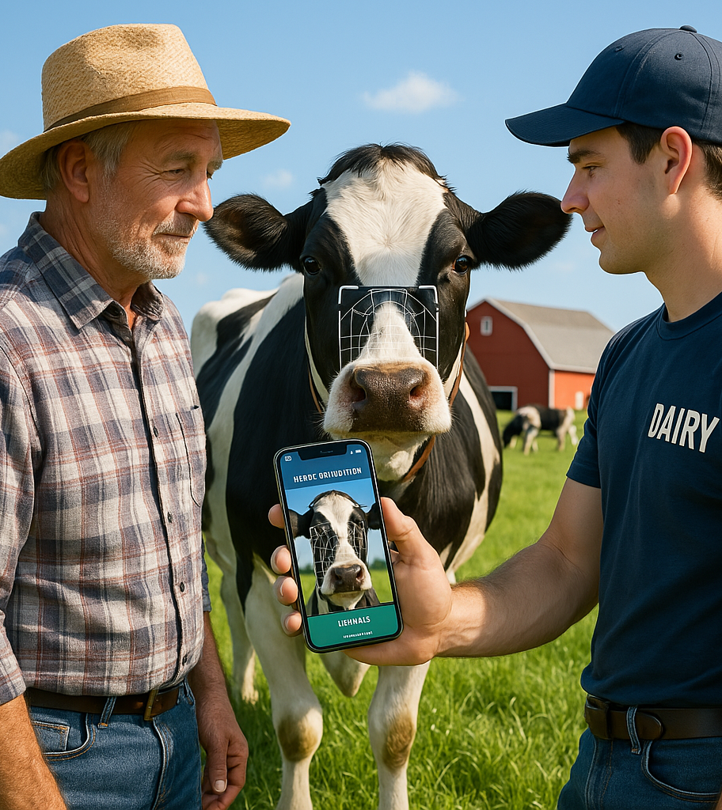
Use Cases
Veterinarian
Livestock Management System

